Slide 1
Unit -1: Introduction
Artificial Intelligence

Slide 2
Intelligence
We call ourselves Homo sapiens—man the wise—because our intelligence is so important to us.
Scientists have proposed two major “consensus” definitions of intelligence:
From Mainstream Science on Intelligence(1994);
A very general mental capability that, among other things, involves the ability to reason, plan, solve problems, think abstractly, comprehend complex ideas, learn quickly and learn from experience.
From Intelligence: Knowns and Unknowns (1995)
Individuals differ from one another in their ability to understand complex ideas, to adapt effectively to the environment, to learn from experience, to engage in various forms of reasoning, to overcome obstacles by taking thought.
Although these individuals differences can be substantial, they can never entirely consistent: a given person’s intellectual performance will vary on different situations.
Complex of “intelligence” are attempts to clarify and organize this complex set of phenomena.

Slide 3
Intelligence
Intelligence is:
the ability to reason
the ability to understand
the ability to create
the ability to learn from experience
the ability to plan and execute complex tasks
Artificial
Made a copy something like natural

Slide 4
Artificial Intelligence
"Giving machines ability to perform tasks normally associated with human intelligence."
Artificial Intelligence is the branch of computer science concerned with making computers behave like humans.
John McCarthy, who coined the term in 1956, defines it as "the science and engineering of making intelligent machines, especially intelligent computer programs.“
Major AI textbooks define artificial intelligence as "the study and design of intelligent agents," where an intelligent agent is a system that perceives its environment and takes actions which maximize its chances of success.

Slide 5
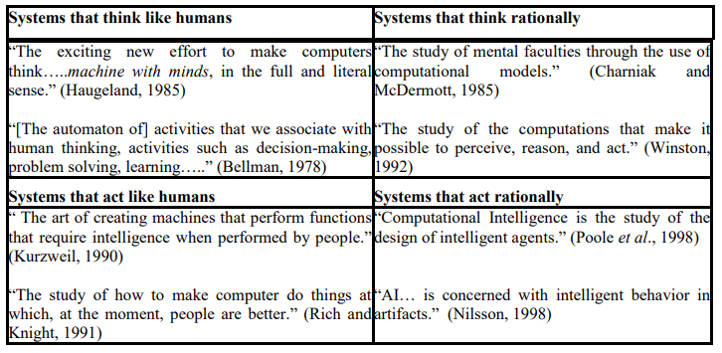
Artificial Intelligence
Different definitions of AI are given by different books/writers. These definitions can be divided into two dimensions.

Slide 6
Artificial Intelligence
Top dimension is concerned with thought processes and reasoning, where as bottom dimension addresses the behavior.
The definition on the left measures the success in terms of fidelity of human performance, whereas definitions on the right measure an ideal concept of intelligence, which is called rationality.
Human-centered approaches must be an empirical science (focuses on practical experience rather than theories), involving hypothesis and experimental confirmation.
A rationalist approach involves a combination of mathematics and engineering.

Slide 7
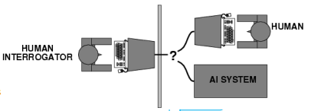
Artificial Intelligence
Acting Humanly : The Turing Test Approach
The Turing Test, proposed by Alan Turing (1950), was designed to provide a satisfactory operational definition of intelligence. He suggested a test based on indistinguishability from undeniably intelligent entities- human beings.
The test involves an interrogator who interacts with one human and one machine. Within a given time the interrogator has to find out which of the two the human is, and which one the machine.

Slide 8
Artificial Intelligence
Acting Humanly : The Turing Test Approach
The computer passes the test if a human interrogator after posing some written questions, cannot tell whether the written response come from human or not.
To pass a Turing test, a computer must have following capabilities:
Natural Language Processing: Must be able to communicate successfully
Knowledge representation: To store what it knows and hears.
Automated reasoning: Answer the Questions based on the stored information.
Machine learning: Must be able to adapt in new circumstances.

Slide 9
Artificial Intelligence
Acting Humanly : The Turing Test Approach
Turing test avoid the physical interaction with human interrogator. Physical simulation of human beings is not necessary for testing the intelligence. The total Turing test includes video signals and manipulation capability so that the interrogator can test the subject’s perceptual abilities and object manipulation ability.
To pass the total Turing test computer must have following additional capabilities:
Computer Vision: To perceive objects
Robotics: To manipulate objects and move

Slide 10
Artificial Intelligence
Thinking Humanly: Cognitive modeling approach
If we are going to say that a given program thinks like a human, we must have some way of determining how humans think.
We need to get inside the actual workings of human minds.
There are ways to do this: -
Through introspection: catch our thoughts while they go by
Through psychological experiments: observing a person in action;
Through brain imaging: observing the brain in action
Once we have precise theory of mind, it is possible to express the theory as a computer program.
But unfortunately until up to now there is no precise theory about thinking process of human brain. Therefore it is not possible to make the machine that think like human brain.

Slide 11
Artificial Intelligence
Thinking rationally: The laws of thought approach
Aristotle was one of the first who attempt to codify the right thinking that is irrefutable reasoning process.
He gave Syllogisms that always yielded correct conclusion when correct premises are given.
Syllogism is a kind of logical argument that applies deductive reasoning to arrive at a conclusion based on two or more propositions that are assumed
For example: Ram is a man
All men are mortal
Ram is mortal

Slide 12
Artificial Intelligence
Thinking rationally: The laws of thought approach
This study initiated the field of logic:
The logicist tradition in AI hopes to create intelligent systems using logic programming.
However there are two obstacles to this approach.
First, It is not easy to take informal knowledge and state in the formal terms required by logical notation, particularly when knowledge is not 100% certain.
Second, solving problem principally is different from doing it in practice. Even problems with certain dozens of fact may exhaust the computational resources of any computer unless it has some guidance as which reasoning step to try first.

Slide 13
Artificial Intelligence
Acting Rationally: The rational Agent approach:
Agent is something that acts.
Of course, all computer programs do something but computer agent is expected to have following attributes:
Autonomous control
Perceiving their environment
Persisting over a prolonged period of time
Adapting to change
Create and pursue goals
Rational behavior: doing the right thing.
The right thing: that which is expected to maximize goal achievement, given the available information.
Rational Agent is one that acts so as to achieve the best outcome or, when there is uncertainty, the best expected outcome.

Slide 14
Artificial Intelligence
Acting Rationally: The rational Agent approach:
In the laws of thought approach to AI, the emphasis was given to correct inferences.
• Making correct inferences is sometimes part of being a rational agent, because one way to act rationally is to reason logically to the conclusion and act on that conclusion.
• On the other hand, there are also some ways of acting rationally that cannot be said to involve inference.
• For Example, recoiling from a hot stove is a reflex action that usually more successful than a slower action taken after careful deliberation.

Slide 15
Artificial Intelligence
Acting Rationally: The rational Agent approach:
It is more general than laws of thought approach, because correct inference is just one of several mechanisms for achieving rationality.
It is more amenable to scientific development than are approaches based on human behavior or human thought because the standard of rationality is clearly defined and completely general.

Slide 16
Foundations of AI
Philosophy:
A theory or attitude that acts as a guiding principle for behavior.
Is the study of the fundamental nature of knowledge, reality, logic, rationally.
Artificial intelligence has close connections with philosophy because both share several concepts like intelligence, action, consciousness.
The philosophy of artificial intelligence attempts to answer the such questions:
Where does knowledge come from?
Can a machine act intelligently? Can it solve any problem that a person would solve by thinking?
Are human intelligence and machine intelligence the same?

Slide 17
Foundations of AI
Mathematics:
Deals with how formal knowledge can be represented.
How algorithms, computation, inferencing are used?
What are the formal rules to draw the valid conclusions?
What can be computed?
How do we reason with uncertain information?

Slide 18
Foundations of AI
Psychology:
The scientific study of the human mind and its functions, especially those affecting behavior in a given context.
The psychology in artificial intelligence attempts to answer such questions:
How humans think and act?
How different context makes the difference?
Economics:
The branch of knowledge concerned with the production, consumption and transfer of wealth.
It attempts to answer following questions:
How should we make decisions so as to maximize payoff?
How should we do this when others may not go along?
How should we do this when the payoff may be far in future?

Slide 19
Foundations of AI
Linguistics:
Study of language and its structure, including the study of grammar, syntax and phonetics
It focuses:
Knowledge representation
Knowledge of grammar
Relating language to thought
Neuroscience:
Study of biological nervous system
It focuses on:
How do brains process information?
If the theory can be extracted?

Slide 20
Foundations of AI
Computer Engineering:
How to build efficient and powerful computers?
Control Theory:
A branch of applied mathematics
In control theory a system of differential equations are given that describe a physical system like robot or an aircraft.
Modify certain terms to the differential equation and that will change their behavior.
It focuses on:
How can artifacts operate under their own control?

Slide 21
History of AI

Slide 22
Applications of AI
Robotic Vehicles: A driverless robotic car named STANLEY sped through the rough terrain of the Mojave dessert at 22 mph, finishing the 132-mile course first to win the 2005 DARPA Grand Challenge. STANLEY is a Volkswagen Touareg outfitted with cameras, radar, and laser rangefinders to sense the environment and onboard software to command the steering, braking, and acceleration
Speech recognition: A traveler calling United Airlines to book a flight can have the entire conversation guided by an automated speech recognition and dialog management system.
Autonomous planning and scheduling: A hundred million miles from Earth, NASA’s Remote Agent program became the first on-board autonomous planning program to control the scheduling of operations for a spacecraft
Game Playing: IBM’s DEEP BLUE became the first computer program to defeat the world champion in a chess match when it bested Garry Kasparov by a score of 3.5 to 2.5 in an exhibition match.

Slide 23
Applications of AI
Spam fighting: Each day, learning algorithms classify over a billion messages as spam, saving the recipient from having to waste time deleting what, for many users, could comprise 80% or 90% of all messages, if not classified away by algorithms.
Robotics: The iRobot Corporation has sold over two million Roomba robotic vacuum cleaners for home use. The company also deploys the more rugged PackBot to Iraq and Afghanistan, where it is used to handle hazardous materials, clear explosives, and identify the location of snipers.
Machine Translation: A computer program automatically translates from one language to other.
Product Recommendation: widely used by various e-commerce and entertainment companies such as Amazon, Netflix, etc., for product recommendation to the user.

Slide 24
Thank you!

